Slide 1
Unit Testing and Test Driven Development (TDD)

Slide 2
What Is Unit Testing?
A test, at its simplest, is something that "runs the code under test".
When software developers write source code, someone needs to validate that this code performs as expected.
In order to do so, a team of software testers usually runs the source code in question.

Slide 3
What Is Unit Testing?
When running code "under test", a tester runs a selection of source code in order to ascertain whether or not the actual result of running that selection was the expected result.
The expected result is determined by the software requirements specifications and the test data used for the test.
If the actual result of a test differs from the expected result, that test is a failed test.
The result of a failed test is known as a defect.
Once a software tester finds a defect, a software developer might attempt to modify the source code in a way that causes the source code to produce the expected result when supplied with the same test data that led the test to fail.

Slide 4
What Is Unit Testing?
This process of running source code under test is often conducted both manually and via an automation framework.
One software tester might manually input test data while running the application and report the results of doing so using a reporting tool.
Yet another tester, however, might write unit tests in their language of choice and package those tests with the source code so that the development team can easily run test scripts once the source code is delivered to a central repository.

Slide 5
What Is Unit Testing?
Unit testing, on the other hand, is about more than running source code against tests.
Unit tests prioritize testing source code in isolation.
This process entails testing the "smallest" unit of code possible. This unit is often, for instance, a single method.
If a unit should depend on another unit, testers typically use mocks or stubs in order to isolate the unit from its dependency during the test.

Slide 6
Benefits of Unit Testing
Encourages Writing Testable Code
Isolate Defects In Source Code
Cost-Effective
Improves Overall Code Quality
Confidence When Refactoring

Slide 7
Test-Driven Development (TDD)
Test-driven development (TDD) is an approach to software development in which each line of code is "written in response to a test that a programmer writes just before coding".
In other words, test-driven development emphasizes a "test-first" approach in which programmers create test cases first and then write source code which passes these tests.
When using a test-driven approach to software development, programming, testing, and refactoring code are closely intertwined.
A developer who subscribes to test-driven development typically writes the appropriate test cases, writes the source code, runs the tests, and then refactors the code as necessary.

Slide 8
Benefits of Test-Driven Development
Introduction of Fewer Defects Into Source Code
Improved Software Design

Slide 9
The Hazards of Test-Driven Development
Writing a Large Number of Tests At Once
Creating Extremely Trivial Tests
Creating Tests That Are Too Broad

Slide 10
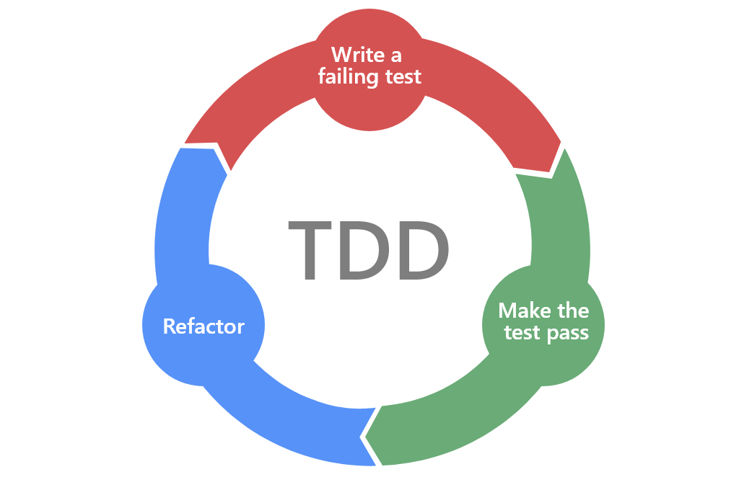
Test-Driven Development (TDD)

Slide 11
Implementing Test-Driven Development
Write a unit test (or several unit tests) which details a feature of the application you're writing.
The source code for this feature of the application should not exist before writing the test.
Run the test you have just written.
Needless to say, the test will fail as you have not yet written the source code for the feature.
Write the source code which will make the test pass.
Don't make the source code overly complex; it should do just enough to pass the the test.
If the test fails, refactor the source code. Again, don't make the source code complex.
Just refactor the code until it passes the test.
Even if the test passes, you might also refactor the code to make it simpler and more concise.
Repeat this process for all other features you implement.

Slide 12
Data-Driven Tests
A data-driven test (DDT) is a test which a developer runs with several different sets of data.
The test runs once for each set of data provided.
The data should be externalized and fed into the test instead of being hard-coded.

Slide 13
Writing Testable Code
Testable code is, quite simply, code that is easy to test.
Performing state and behavior verification becomes simple when your code is written to be testable.

Slide 14
Writing Testable Code –
Don’t | Do’s
Engage In Tight Coupling | Favor Dependency Injection
Hard-code values | Use the Single Responsibility Principle
Use Hidden Dependencies
Mix Concerns
Rely Too Much On static Resources
Build Application Logic Into Constructors

Slide 15
What Is JUnit?
JUnit is a popular, open-source testing framework for Java.

Slide 16
What Is A Test Stub?
A test stub is a piece of code or a program that simulates the behavior of a portion of software that is under test.
Although a stub simulates behavior, its end goal is typically not to verify that behavior.
The goal is to instead verify state as a part of the testing process.
As a result, a stub usually provides a predetermined answer or response rather than recreating the behavior it is replacing.

Slide 17
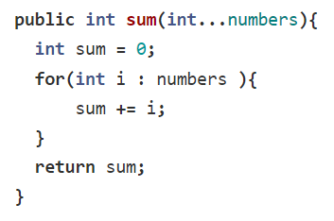
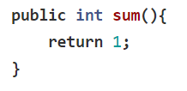
Test Stub
The behavior of the above method is simple. It takes an array of numbers, adds them together, and returns the sum to the caller. A method stub for this method could look like the following.
Notice that the behavior of the original method is completely gone. It has been replaced with a canned answer of 1. In this way, we can see that this method stub isn't useful for verifying the behavior of the source code it replaces. It is simply a temporary replacement for that method in a testing environment, one that allows developers to easily verify state changes using a canned return value that is easy to handle within a test suite.

Slide 18
Test Mock
A test mock is a mock object that mimics the behavior of a real object.
The primary goal of using a test mock is to verify the behavior of an object under test.
This approach to testing is also called behavior verification.
Developers can create test mocks either manually or through the use of a mocking framework.

Slide 19
How a Test Mock Differs From a Stub
There is sometimes confusion about the difference between test mocks and test stubs.
A test mock is NOT a test stub, though they are both test doubles.
A test double is an object that takes the place of a real object for the purpose of testing.
A test stub is about state verification.
In other words, developers use test stubs when they want to keep track of the state changes on objects under test and their collaborators.
A test mock, on the other hand, is about behavior verification.
When developers use test mocks, they want to keep track of the behavior of the objects under test and their collaborators.
That is to say, the developers keep track of "behaviors" such as which methods have been called and how many times those methods have been called.

Slide 20
Mockito
Mockito is a mocking framework for unit tests in Java that provides support for writing test stubs and test mocks.
It boasts a simple API which allows for readable tests and simple verification errors.
Because of its ease of use, it is also one of the most popular mocking libraries for Java.

Slide 21
Benefits of Mockito
It eliminates the need to manually mock objects.
All the developer must do when using Mockito is specify the type they would like to mock and Mockito will create the requested mocks at runtime.
Mockito has built-in annotations which make it easy to learn and use.
For instance, a developer only has to use the @Mock annotation in order to create a mock.
The framework allows for simple behavior verification.
Keeping track of the number of times a method is called, for example, is made simple using Mockito's Verify.
It allows for partial mocking.
A partial mock uses the real implementations of some methods rather than mocked method calls.

